Slide 1
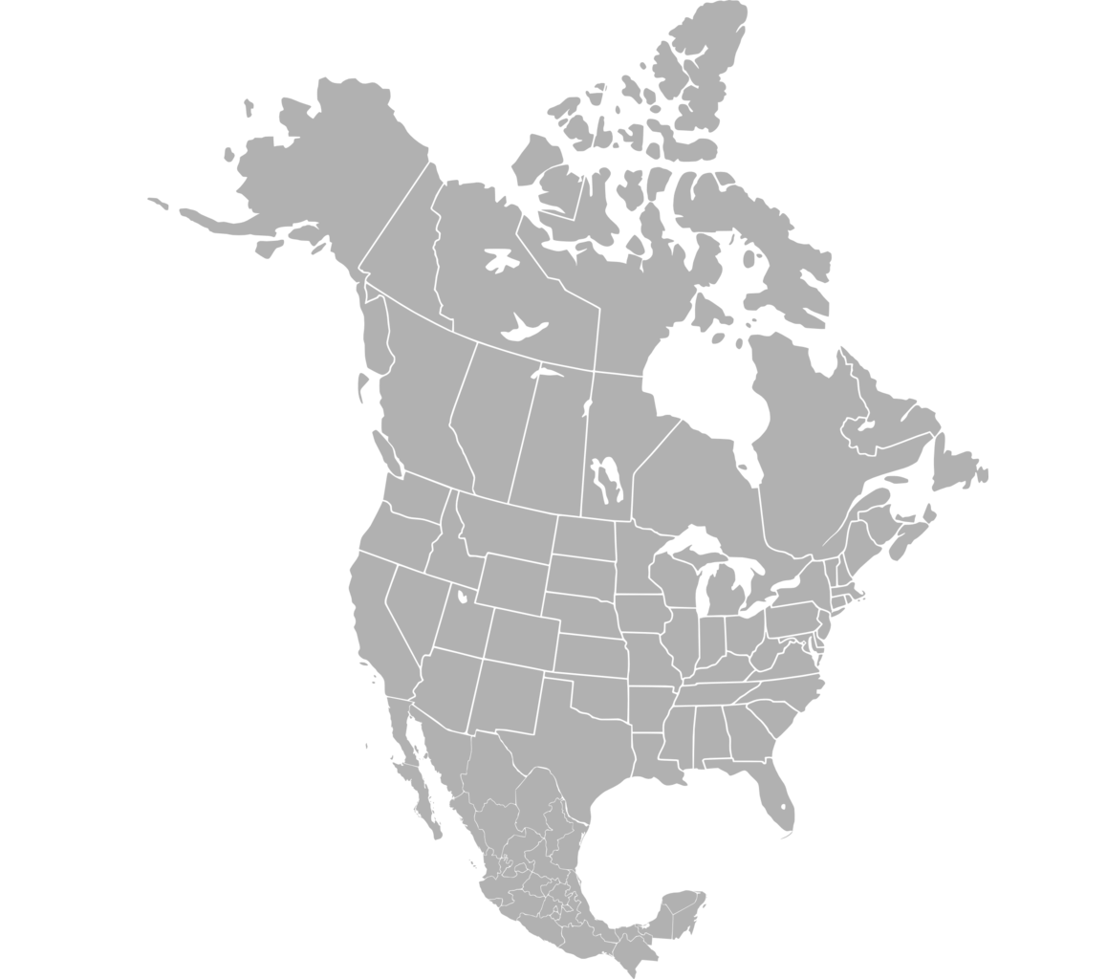
Unveiling Flavor Trends: A Journey through F&B in North America
Presenter: Atishay Jain

Slide 2
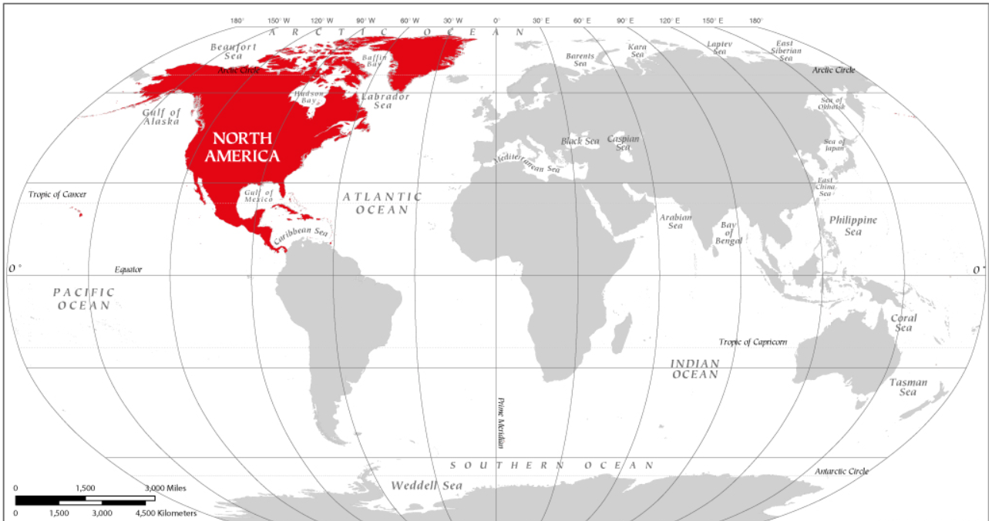

Introduction
Welcome to a captivating exploration of the ever-evolving world of Food and Beverage in North America

Slide 3


Navigating Flavor Challenges in F&B
The Food and Beverage industry is a dynamic landscape where consumer preferences shape market trends.
Challenge: Amidst this dynamism, businesses face a critical challenge — understanding and adapting to emerging flavor trends.

Slide 4
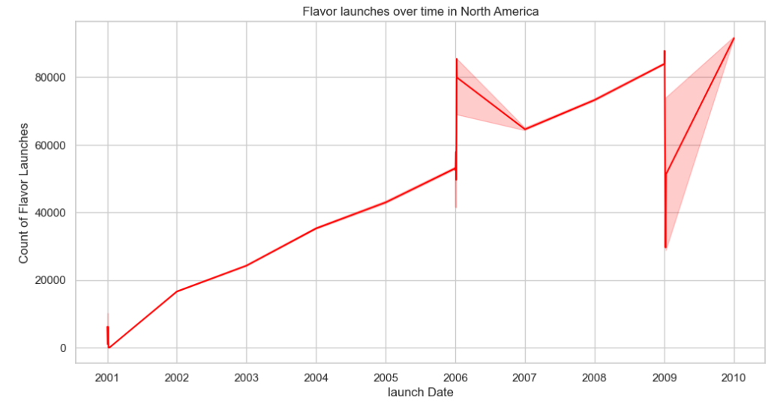
Business Problem Understanding
The fluctuating trend in flavor launches over time highlights the challenge of discerning emerging trends. Without a clear pattern, it becomes crucial to delve deeper into the data to pinpoint and understand evolving flavor preferences, aiding strategic decision-making for product development and marketing in the North America region.

Slide 5
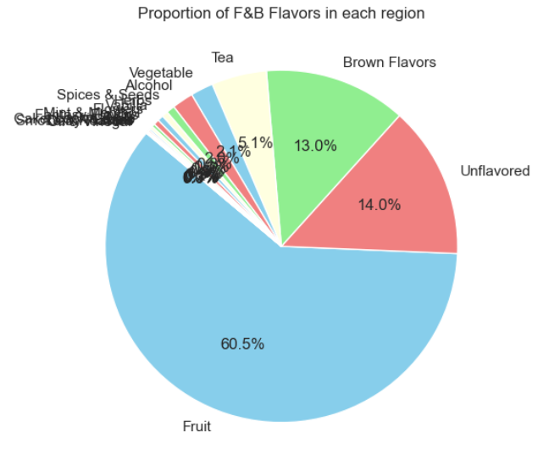
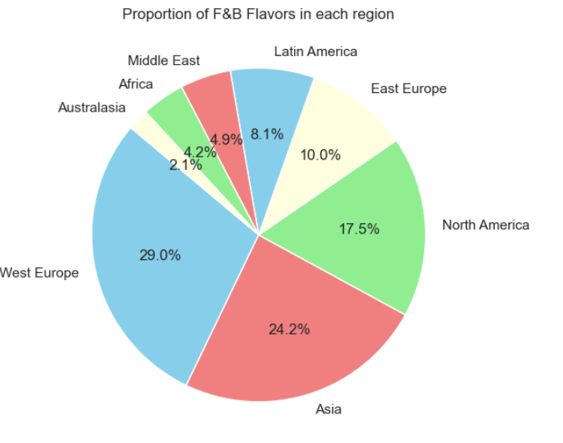
Discoveries in Flavor Dynamics

Slide 6
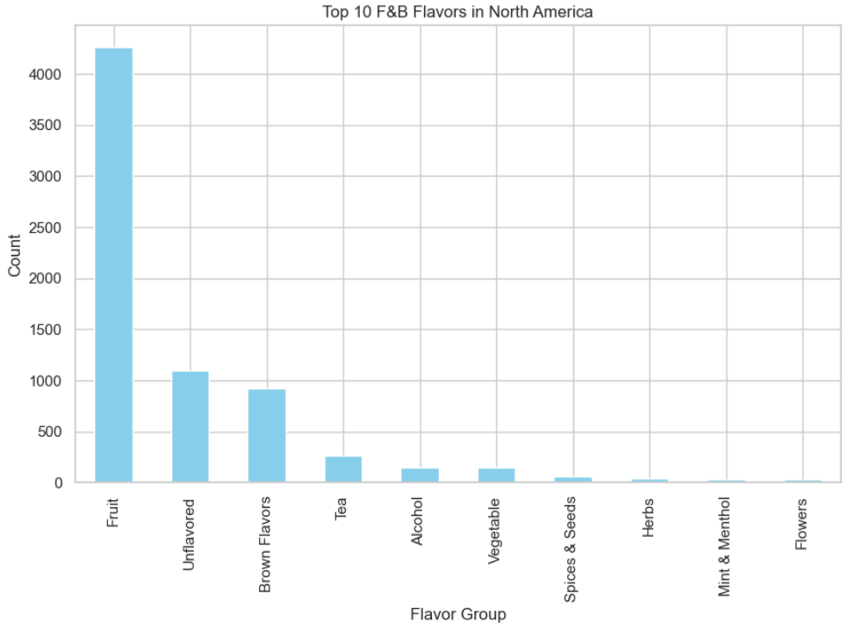
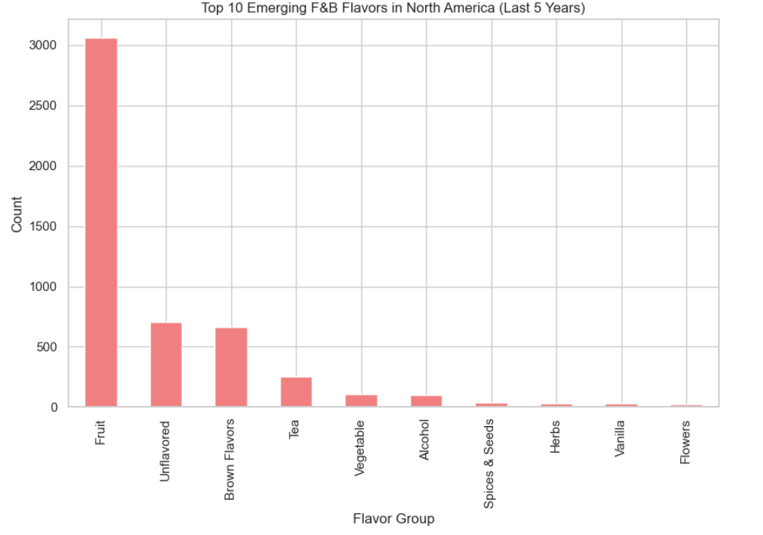
Discoveries in Flavor Dynamics
Most North Americans prefer fruit flavors.
There is a slight difference between unflavored and brown flavors.
Very few North Americans like to have flower, mint, and menthol flavors as they are listed in the top 10

Slide 7
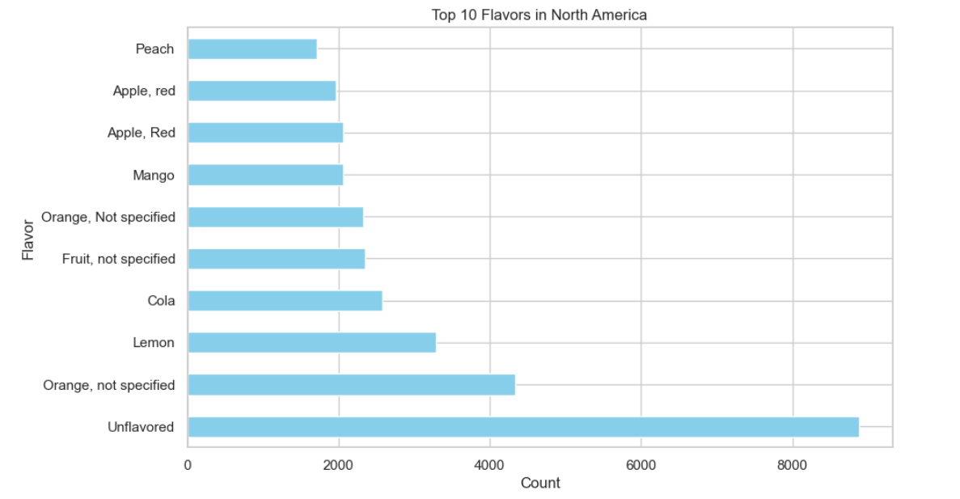
Discoveries in Flavor Dynamics
Most North Americans prefer unflavored foods.
Most North Americans prefer equally Apple and Mango, Orange and nonfruit flavors

Slide 8

Recommendations
Leverage Fruit Flavors
Refine Unflavoured and Brown Options
Strategic Introduction of Unique Flavors
Adapt to Regional Preferences
Continuous Consumer Engagement
Introduce New Variants Strategically
Optimize Positioning and Brand Strategy
Seasonal and Regional Adaptation

Slide 9

Unveiling Flavor Trends: A Strategic Overview
Key Findings
Implications for Decision-Making
Data-Driven Approach
Recommendations for Future Actions

Slide 10

Questions and Answers

Slide 11


